Slide 1
Presentation Summary:
What is CSS?
How to CSS?
CSS Selectors.
The end
Presentation by: Saroj Devkota
Group: LGCG6

Slide 2

Where to CSS??
Atom
Visual Studio Code
Brackets
Espresso(For Mac OS User)
Notepad++(Great for HTML & CSS)
Komodo Edit (Simple)
Sublime Text (Best Editor)

Slide 3
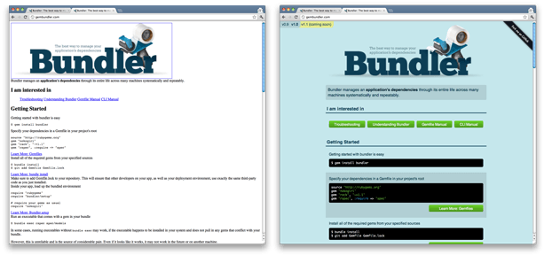
After CSS
Before CSS
This website is more appealing even though it functions similarly to the un-styled website.
This website looks dull and unmanaged and shows a lack of interest by the creators.

Slide 4

How to CSS???
1) Inline CSS
An inline style may be used to apply a unique style to a single element.
To use inline styles, add the style attribute to the relevant element. The style attribute can contain any CSS property.
Why not Inline CSS???
Content is mixed with design
Maintenance is more complex
Inline styles can make your page slower
Inline CSS can not be reused

Slide 5
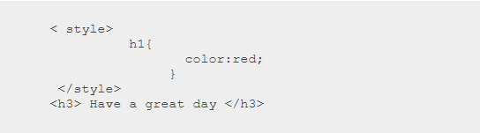
2) Internal CSS
An internal style sheet may be used if one single HTML page has a unique style.
The internal style is defined inside the <style> element, inside the head section.
Advantages of Internal CSS:
You can use class and ID selectors in this style sheet.
Since you’ll only add the code within the same HTML file, you don’t need to upload multiple files.
Disadvantages of Internal CSS:
Adding the code to the HTML document can increase the page’s size and loading time.

Slide 6
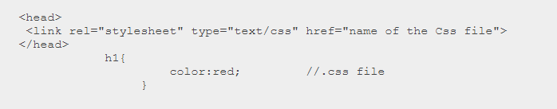
3) External CSS
With an external style sheet, you can change the look of an entire website by changing just one file!
Each HTML page must include a reference to the external style sheet file inside the <link> element, inside the head section.
Advantages of External CSS:
Since the CSS code is in a separate document, your HTML files will have a cleaner structure and are smaller in size.
You can use the same .css file for multiple pages.
Disadvantages of External CSS:
Your pages may not be rendered correctly until the external CSS is loaded.
Uploading or linking to multiple CSS files can increase your site’s download time.

Slide 7
CSS Selector
CSS selectors are used to selecting the content you want to style. Selectors are the part of CSS rule set. CSS selectors select HTML elements according to their id, class, type, attribute, etc.
Types of CSS Selectors:
1) Element selector
Selects all elements that have the given node name.
Syntax: elementname
Example: input will match any <input> element.

Slide 8
2) Universal selector
Selects all elements. Optionally, it may be restricted to a specific namespace or to all namespaces.
Syntax: * ns|* *|*
Example: * will match all the elements of the document.
3) Class selector
Selects all elements that have the given class attribute.
Syntax: .classname
Example: .index will match any element that has class="index".

Slide 9
4) ID selector
Selects an element based on the value of its id attribute. There should be only one element with a given ID in a document.
Syntax: #idname
Example: #toc will match the element that has id="toc".
5) Attribute selector
Selects all elements that have the given attribute.
Syntax: [attr] [attr=value] [attr~=value] [attr|=value] [attr^=value] [attr$=value] [attr*=value]
Example: [autoplay] will match all elements that have the autoplay attribute set (to any value).

Slide 10
Thank you!!
If you have any problem understanding the topic.
Please Google it.

